Slide 1
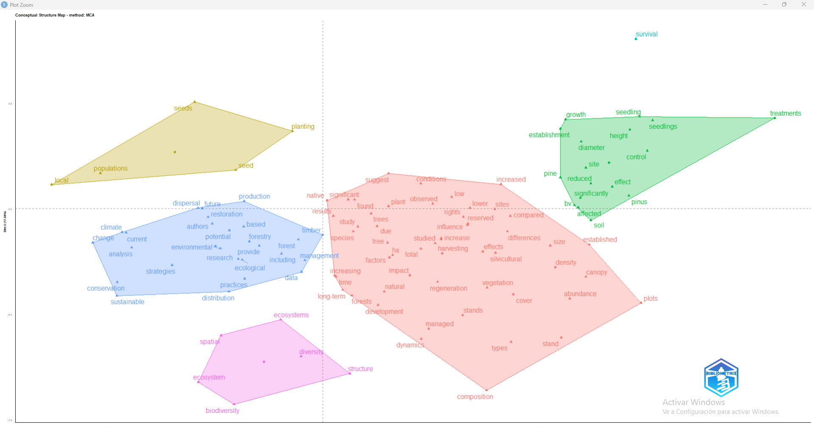
Palabras con co-ocurrencia mayor a 130, se usaron 107 palabras. Selecciono 6 clusters. PC =29.81% y PC2 = 17.39% “Original”

Slide 2
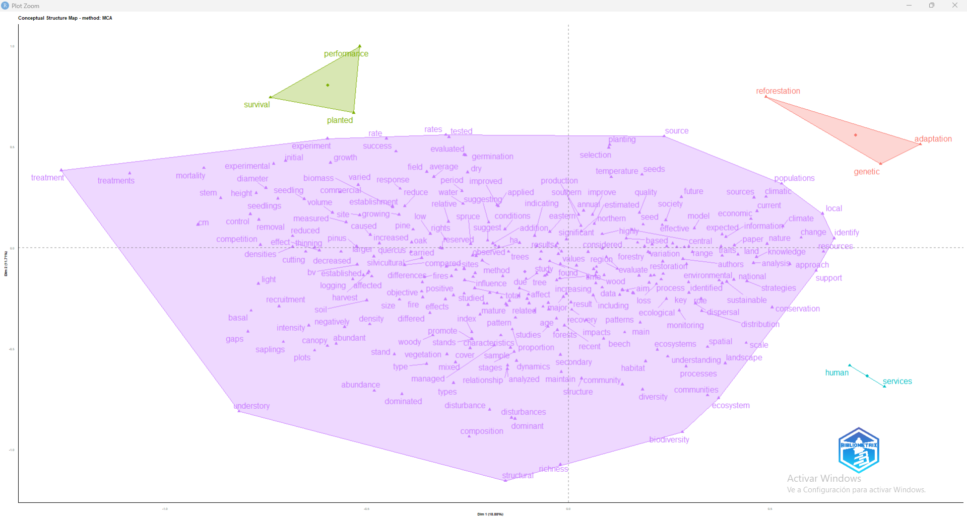
Palabras con co-ocurrencia mayor a 63, se usaron 310 palabras. Selecciono 4 clusters. PC =18.88% y PC2 = 11.71%

Slide 3
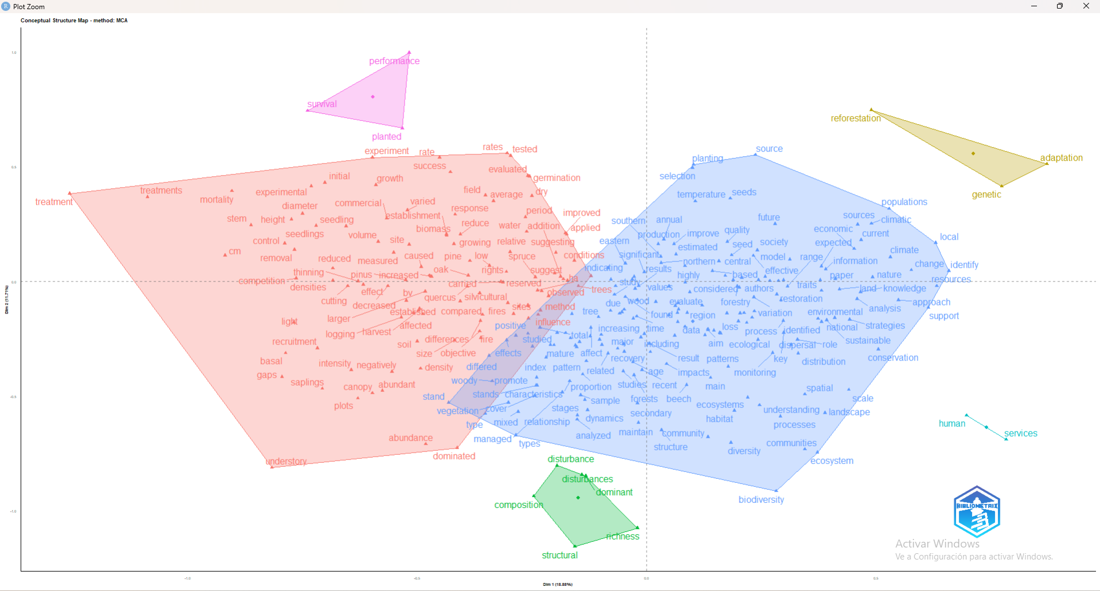
Palabras con co-ocurrencia mayor a 65, se usaron 310 palabras. Selecciono 6 clusters. PC =18.88% y PC2 = 11.71%

Slide 4
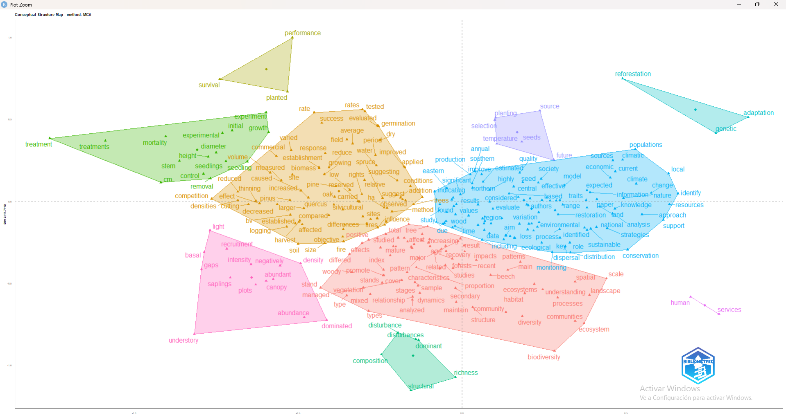
Palabras con co-ocurrencia mayor a 65, se usaron 310 palabras. Selecciono 10 clusters. PC =18.88% y PC2 = 11.71%

Slide 5
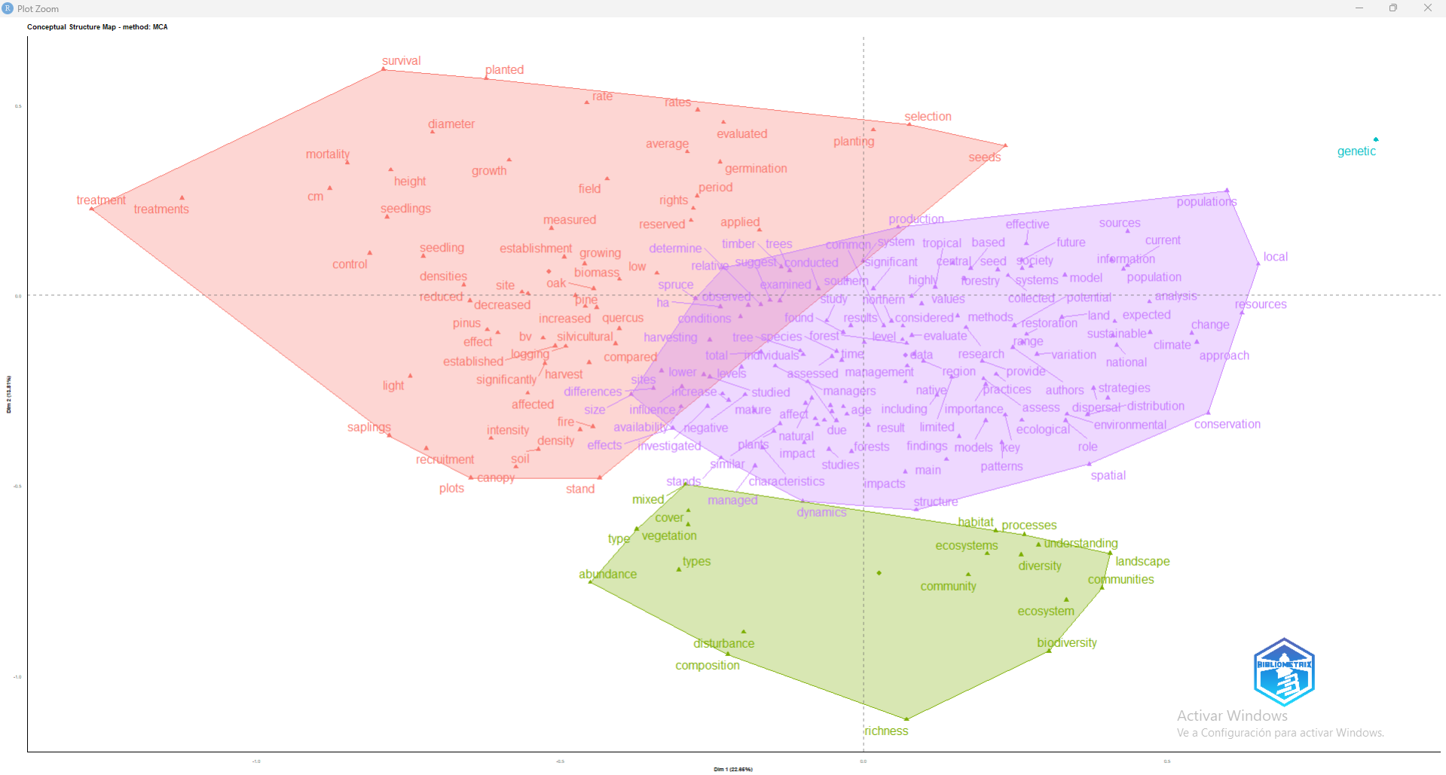
Palabras con co-ocurrencia mayor a 85, se usaron 206 palabras. Selecciono 4 clusters. PC =22.65% y PC2 = 13.81%

Slide 6
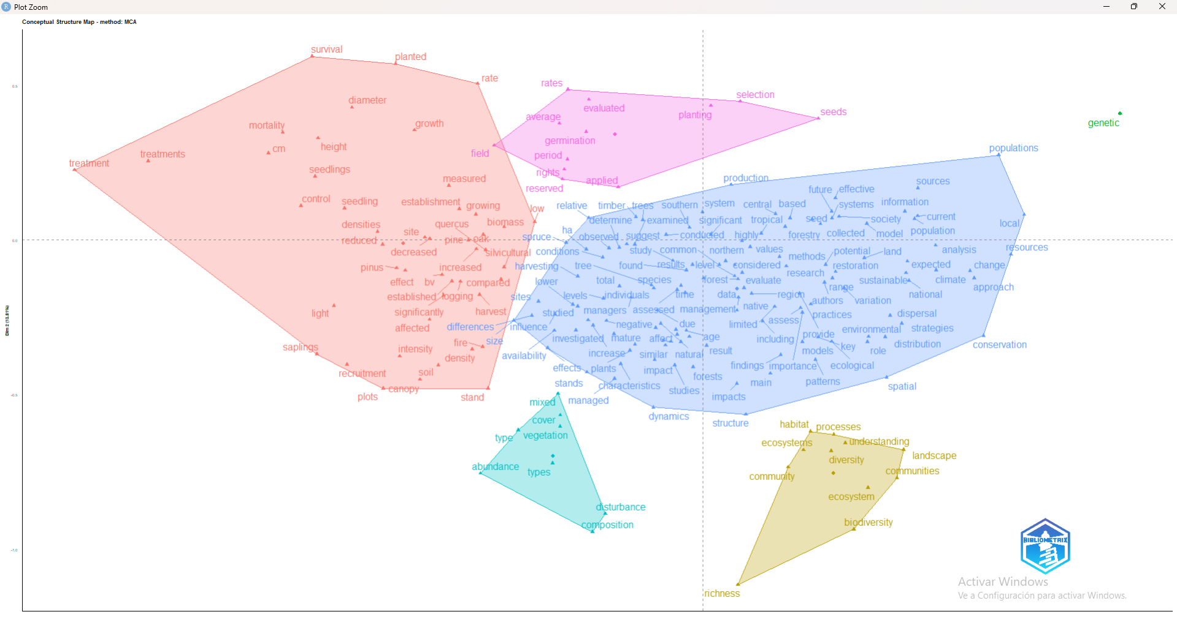
Palabras con co-ocurrencia mayor a 85, se usaron 206 palabras. Selecciono 6 clusters. PC =22.65% y PC2 = 13.81%

Slide 7
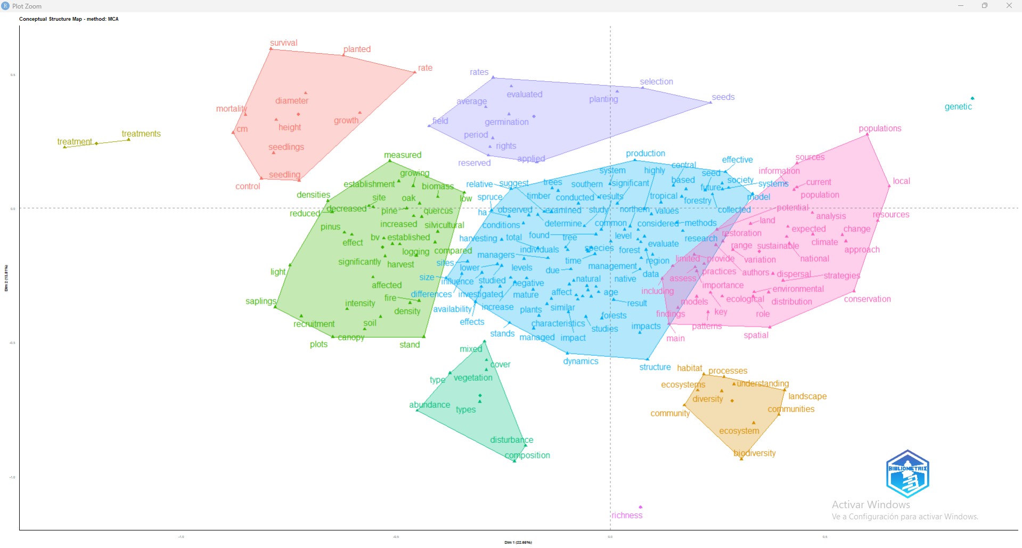
Palabras con co-ocurrencia mayor a 85, se usaron 206 palabras. Selecciono 10 clusters. PC =22.65% y PC2 = 13.81%

